Slide 1

DriverPass System Analysis
Jeffrey Carlson
Notes:
[No speaker notes required for this slide.]

Slide 2

System Requirements
Provide educational resources
Ability to provide feedback
Security
Reliability
Notes:
[In your speaker notes, include an explanation of the different requirements you determined for DriverPass’s system. What are the functional requirements you selected to describe? What are the nonfunctional requirements you selected to describe? Be sure to explain how these requirements meet DriverPass’s needs.]
Provide educational resources to increase the success rate that driverpass students pass the driving test.
Ability for the educational resources and teachers to provide feedback on how the student is doing and how they can improve.
Security and reliability are important to the system to prevent data leaks and to ensure that the system has high up time

Slide 3
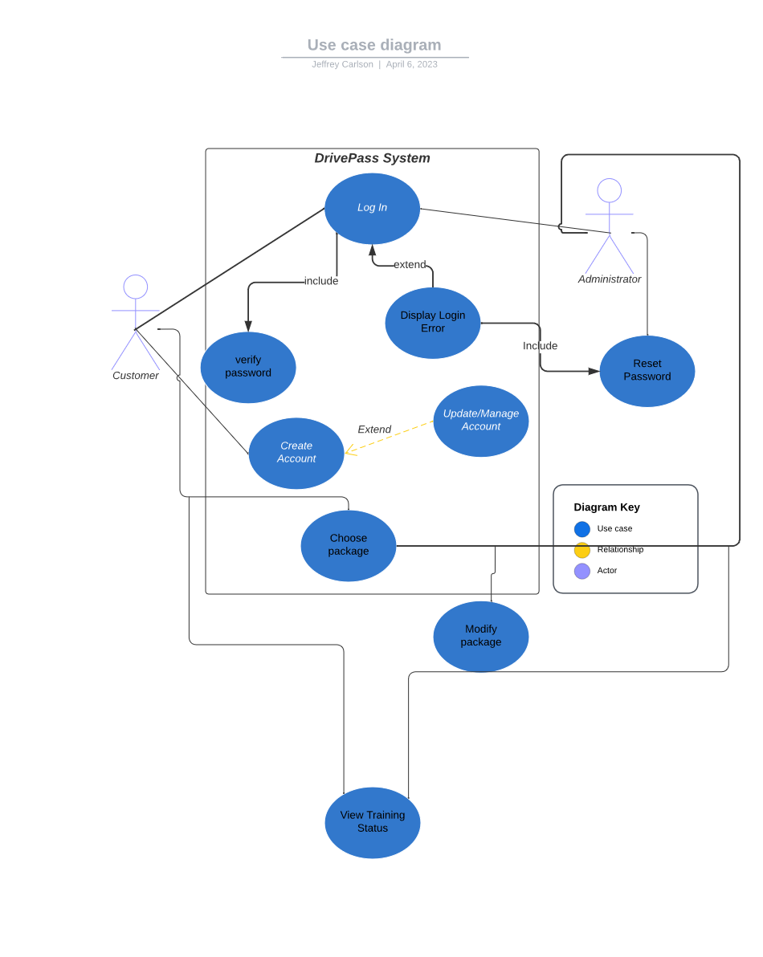
Use Case Diagram
[Insert your use case diagram here.]
Notes:
[Explain your diagram. Who are the different actors in the system? What are the different use cases? How did you account for DriverPass’s needs in your design? In your explanation, keep your audience in mind. Avoid the use of terms like “actors” and “use cases” in your explanation.]
Explain what the diagram means

Slide 4
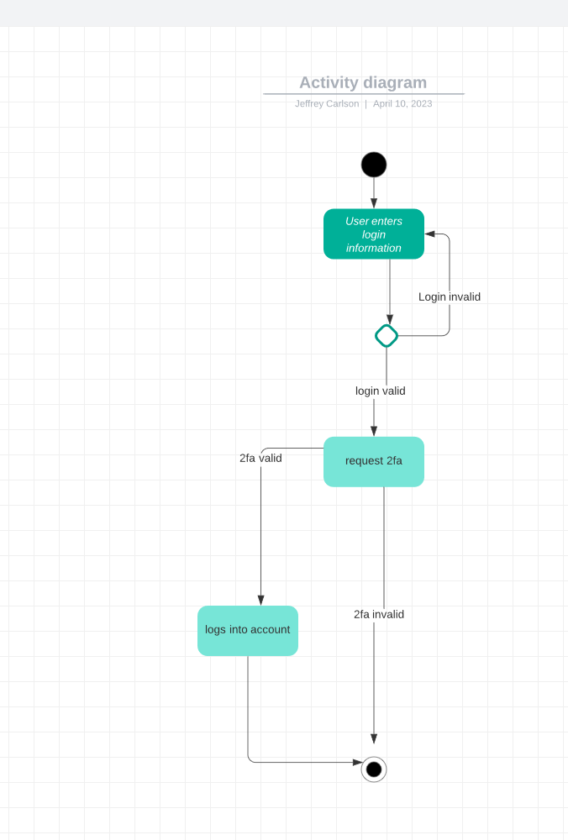
Activity Diagram
[Insert one of your activity diagrams here.]
Notes:
[Explain your diagram. Which use case are you breaking down? What are the steps for this use case? How did you account for DriverPass’s needs in your design? In your explanation, keep your audience in mind. Avoid the use of technical terms such as “nodes,” “control flows,” and so on.]
Explain the diagram in simple person terms

Slide 5
Security
Strong Encryption
Advanced security measures
Salt
Notes:
[How did you consider security in your design? In your explanation, keep your audience in mind by avoiding the use of technical terms.]
Talk about SHA256 and how it’s a pretty cool encryption algorithm with little overlap
Talk about how passwords are salted which makes it nearly impossible for bad actors to crack passwords if the database got leaked

Slide 6
System Limitations
Cannot control person
Notes:
[What are the limitations of your design? In your explanation, keep your audience in mind by avoiding the use of technical terms.]
If the student isn’t motivated to learn there isn’t much you can do

